Slide 1
NUMERICAL ANALYSIS ON HEAT TRANSFER ENHANCEMENT OF POROUS FIN

Slide 2
GROUP MEMBERS
JISHNU JAYARAJ
DEEPAK RAJ A S
PRAVEEN K PRASAD
VISHNU K P
DILDEEP T C
RIYAS V
VISHNU K P
MIDHUN DAS
GUIDED BY
NAVEEN

Slide 3
INTRODUCTION
Thermal management has become a critical aspect of today’s technology, which often include many high-performance machines and circuits that dissipate large amounts of heat. Many of these components require efficient cooling to prevent overheating.
Recent development of high performance devices has added the need for designing an efficient method for heat dissipation.
The performance of electronic system and machines deteriorates precipitously when the temperature of the devices trips beyond a certain threshold limit.

Slide 4
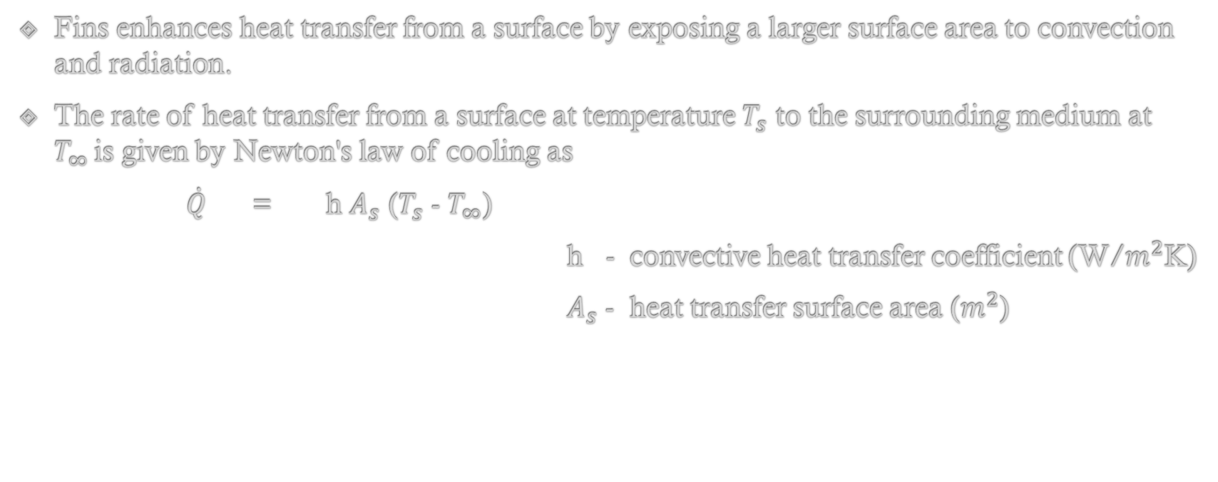
FINS
Fins enhances heat transfer from a surface by exposing a larger surface area to convection and radiation.
The rate of heat transfer from a surface at temperature $T_{s}$ to the surrounding medium at $T_{∞ }$is given by Newton's law of cooling as
$\dot{Q}$ = h $A_{s}$ ($T_{s}$ - $T_{∞}$)
h - convective heat transfer coefficient (W/$m^{2}$K)
$A_{s}$ - heat transfer surface area ($m^{2}$)

Slide 5
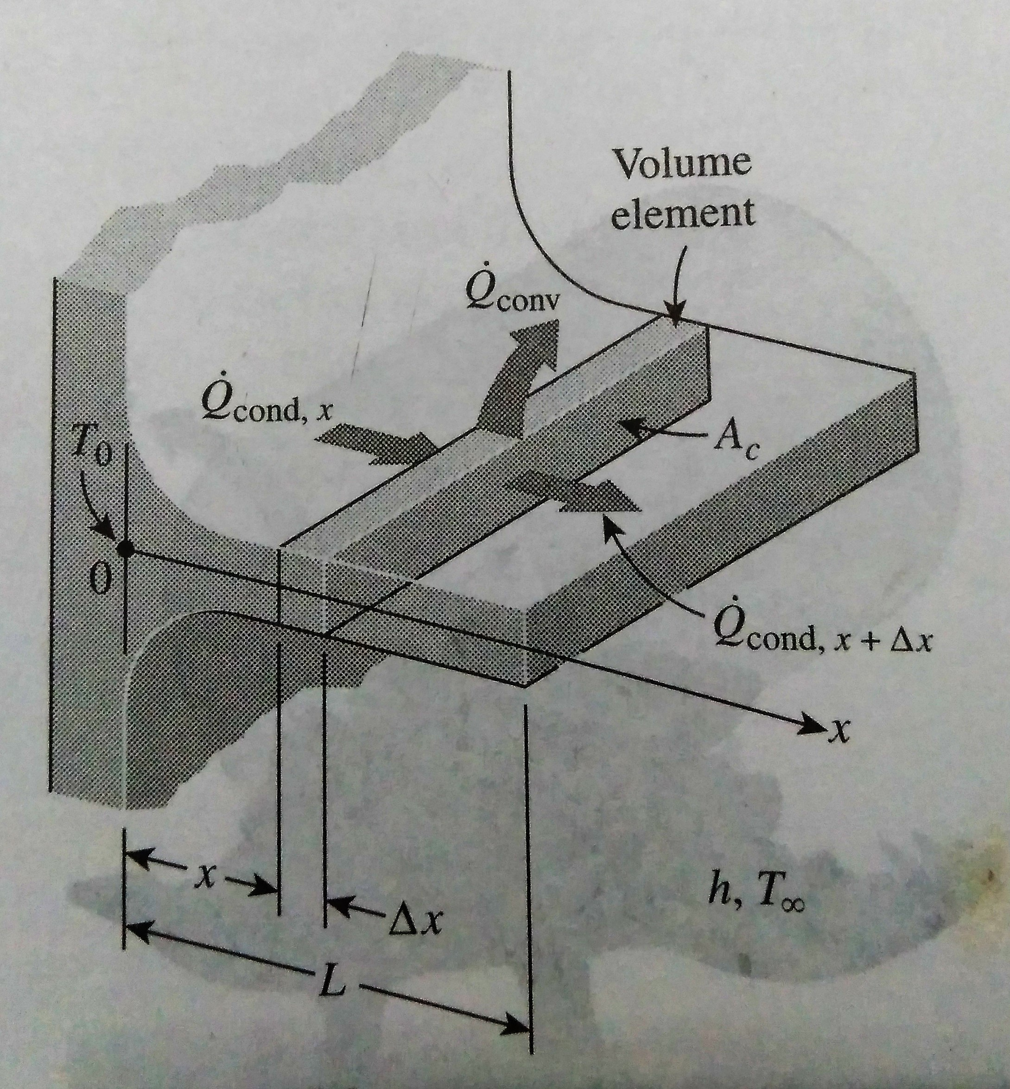
HEAT TRANSFER IN FINS

Slide 6
OBJECTIVE
To develop a CFD model of rectangular fin enclosed in a air domain and then to optimize the heat transfer.
To analyze the thermal performance of fin by comparing temperature contour and velocity contour ,also to study velocity vector.
To compare results of solid fin with porous fin.

Slide 7
SOFTWARE USED
ANSYS 16.0
GEOMETRY
the model is made in ansys design modeler.
MESHING
meshing was done in ansys 16.0 mesh tool.
SIMULATION
the CFD model was simulated in ansys fluent

Slide 8
GEOMETRIC PARAMETERS
Fin
type : solid
length : 100mm
breadth : 50mm
height : 5mm
Air domain
type : fluid
length : 200mm
breadth : 200mm
height : 200mm

Slide 9
GEOMETRY

Slide 10
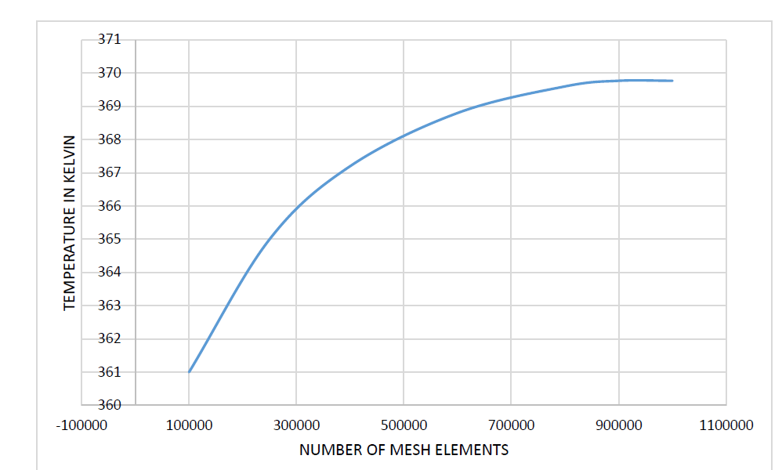
GRID INDEPENDENT STUDY

Slide 11
ASSUMPTIONS AND BOUNDARY CONDITIONS
Heat flux in to the fin is given at the base of the fin. Heat flux = 24000W/m2
Operating temperature is considered as 300K.
Pressure outside the domain is considered as atmospheric (101325Pa).
Boussnnesq equation

Slide 12
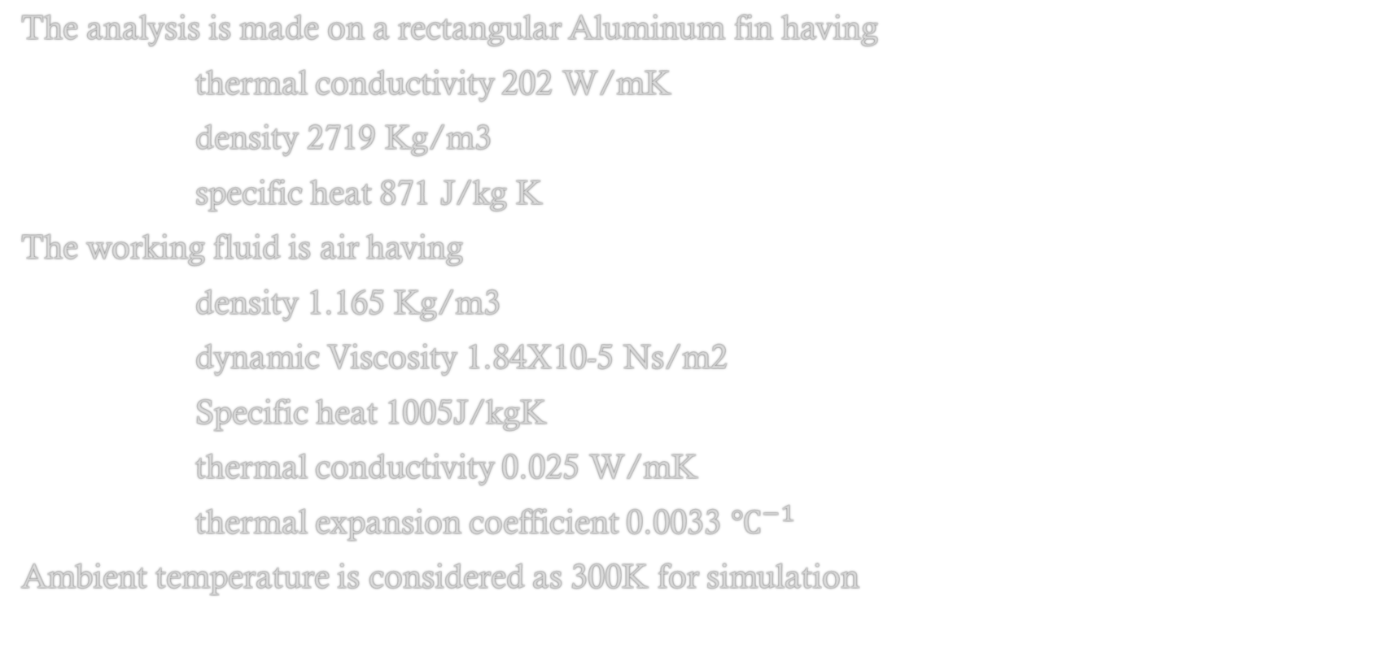
ASSUMPTIONS (CONT)
The analysis is made on a rectangular Aluminum fin having
thermal conductivity 202 W/mK
density 2719 Kg/m3
specific heat 871 J/kg K
The working fluid is air having
density 1.165 Kg/m3
dynamic Viscosity 1.84X10-5 Ns/m2
Specific heat 1005J/kgK
thermal conductivity 0.025 W/mK
thermal expansion coefficient 0.0033 $℃^{−1}$
Ambient temperature is considered as 300K for simulation

Slide 13
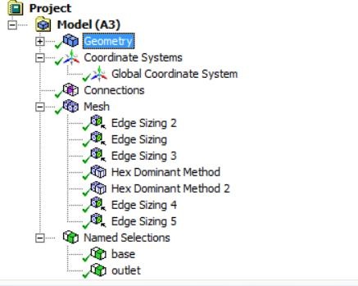
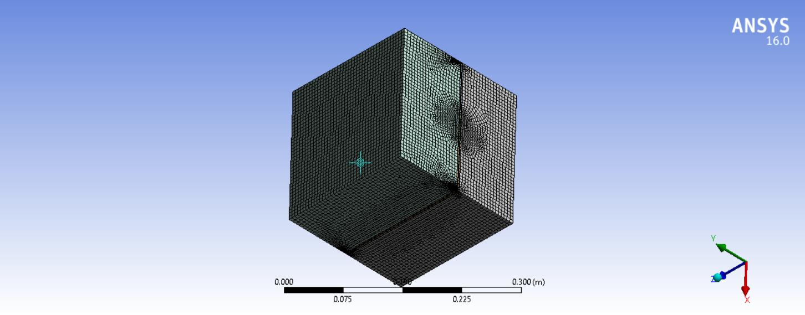
MESH DETAILS

Slide 14
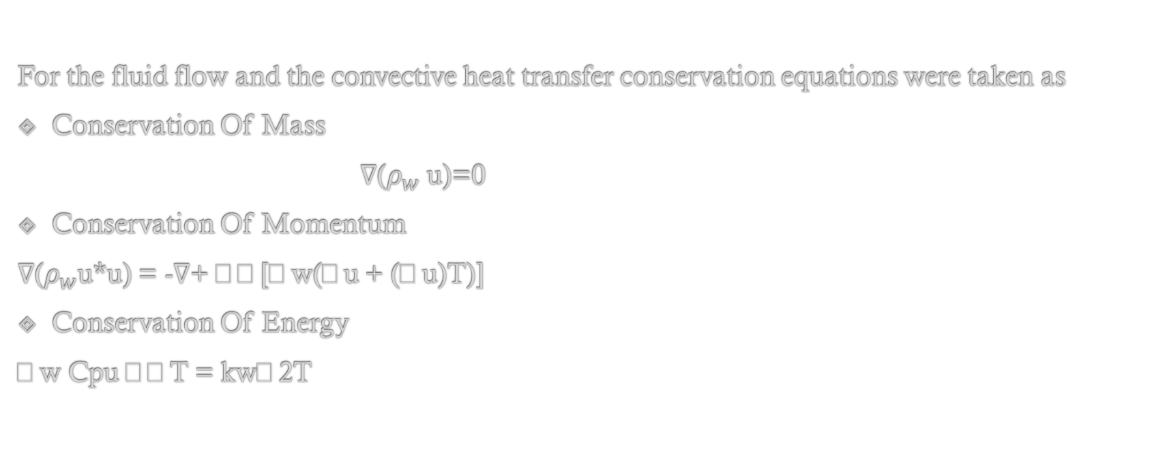
GOVERNING EQUATION
For the fluid flow and the convective heat transfer conservation equations were taken as
Conservation Of Mass
$∇$($ρ_{w}$ u)=0
Conservation Of Momentum
$∇$($ρ_{w}$u*u) = -$∇$+ [w(u + (u)T)]
Conservation Of Energy
w Cpu T = kw2T

Slide 15
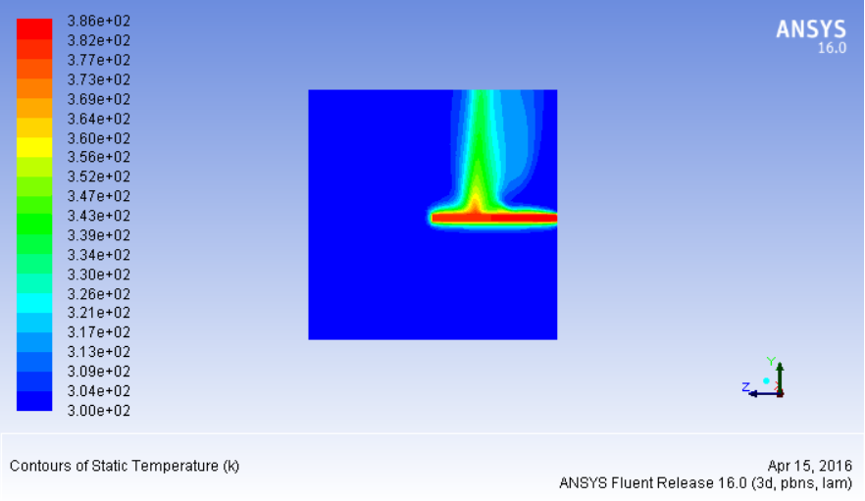
TEMPERATURE CONTOUR OF SOLID FIN

Slide 16
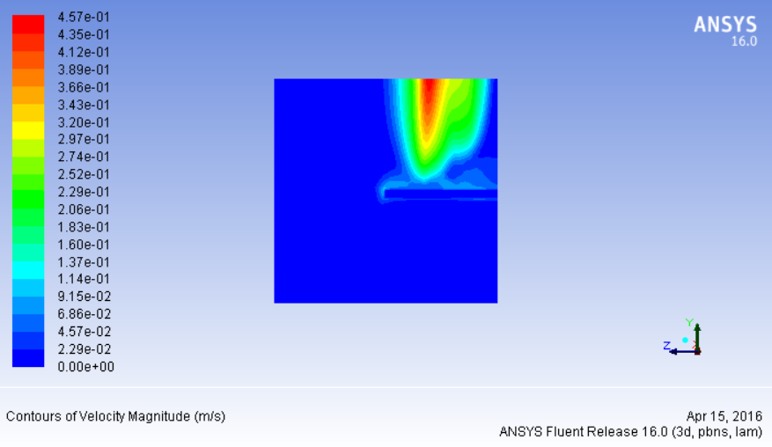
VELOCITY CONTOUR OF SOLID FIN

Slide 17
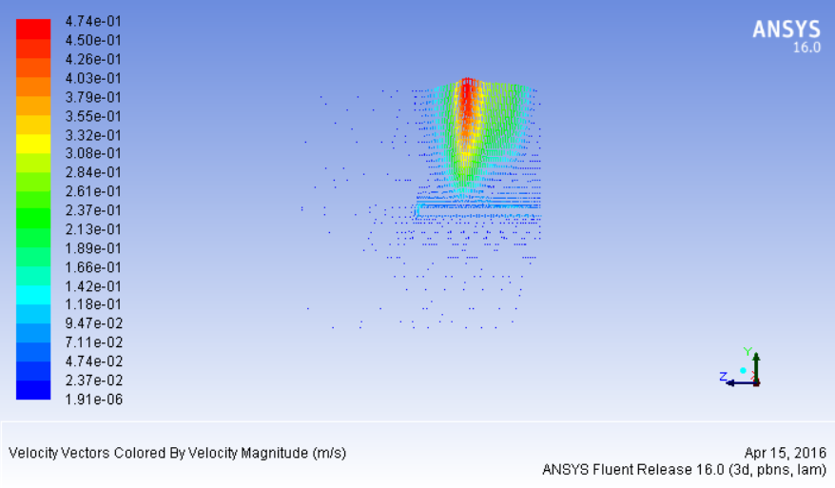
VELOCITY VECTOR OF SOLID FIN

Slide 18
MODIFIED SOLID FIN
We recognize that the convective heat transfer coefficient h, in general, varies along the fin.
Its value at a point is a strong function of the fluid motion at that point.
The value of h is usually much lower at the fin base than it is at the fin tip because the fluid is surrounded by solid surfaces near the base, which disrupts it motion.
So we have modified fin by placing some holes in fin surface.

Slide 19
MODIFIED SOLID FIN

Slide 20
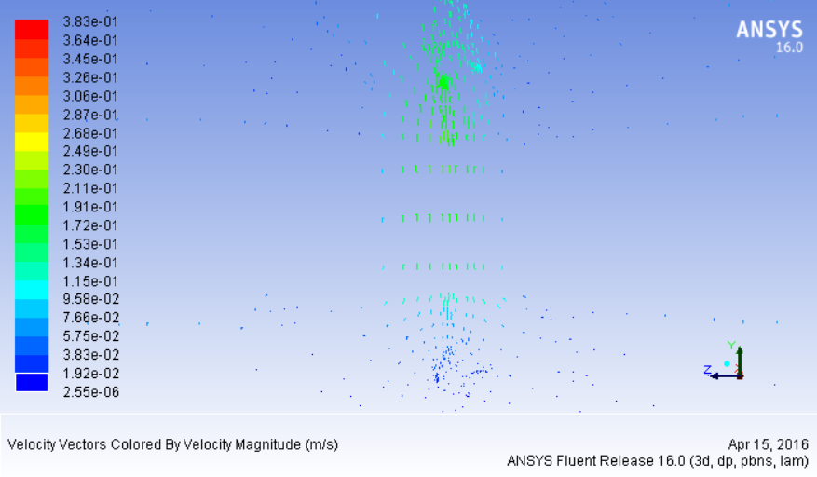
VELOCITY VECTOR FOR POROUS FIN

Slide 21
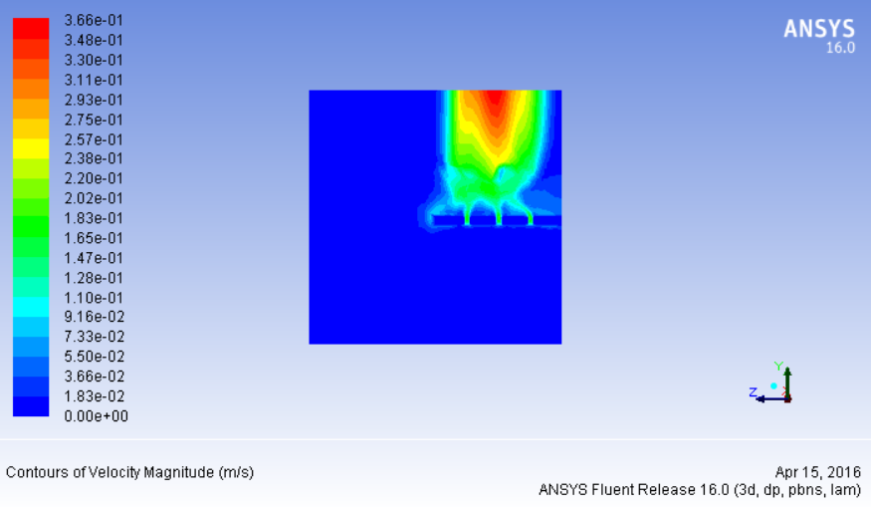
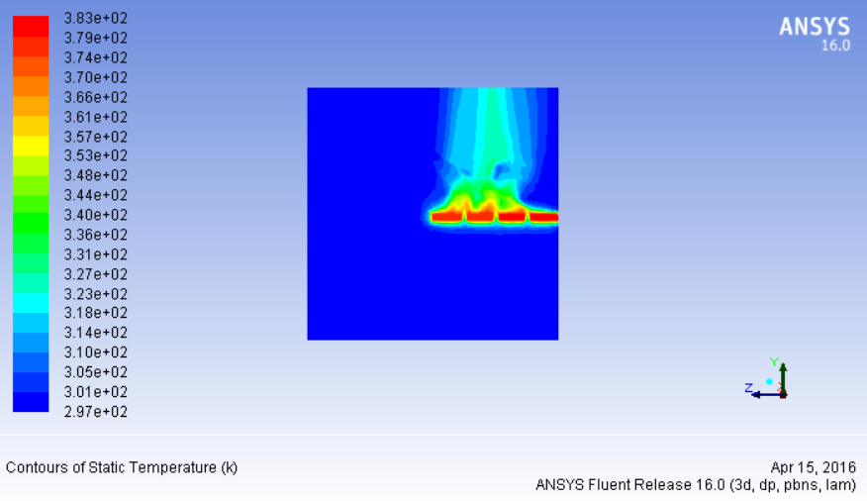
TEMPERATURE AND VELOCITY CONTOUR

Slide 23
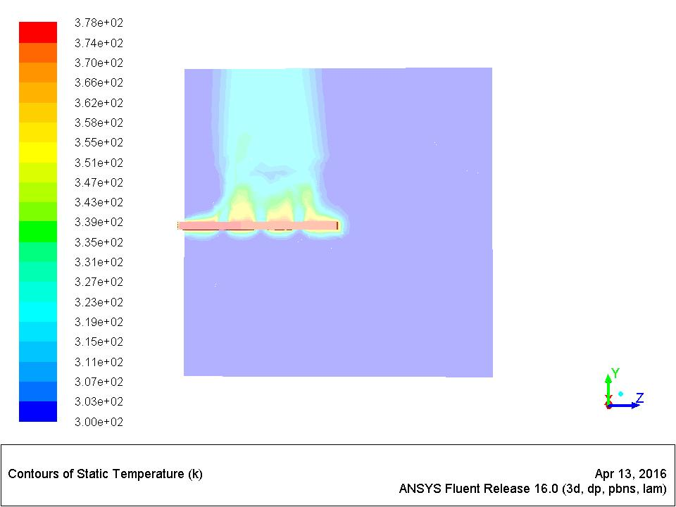
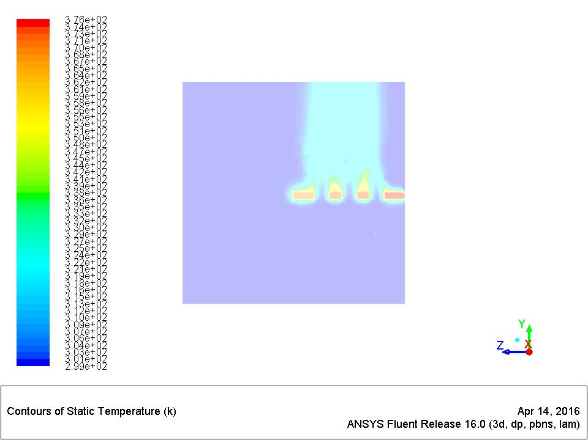
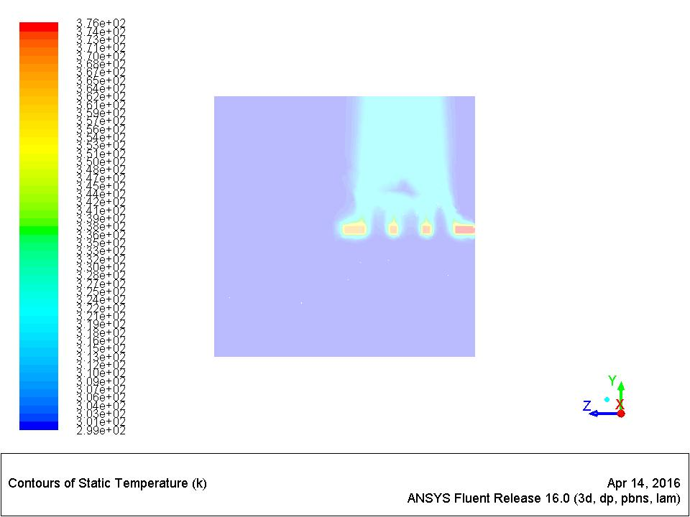
EFFECT OF INCREASING HOLE DIA
10mm hole dia 15mm hole dia 20mm hole dia

Slide 24
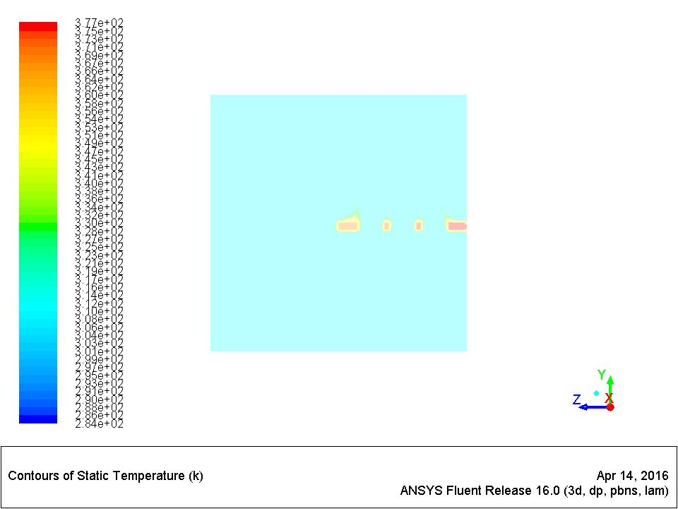
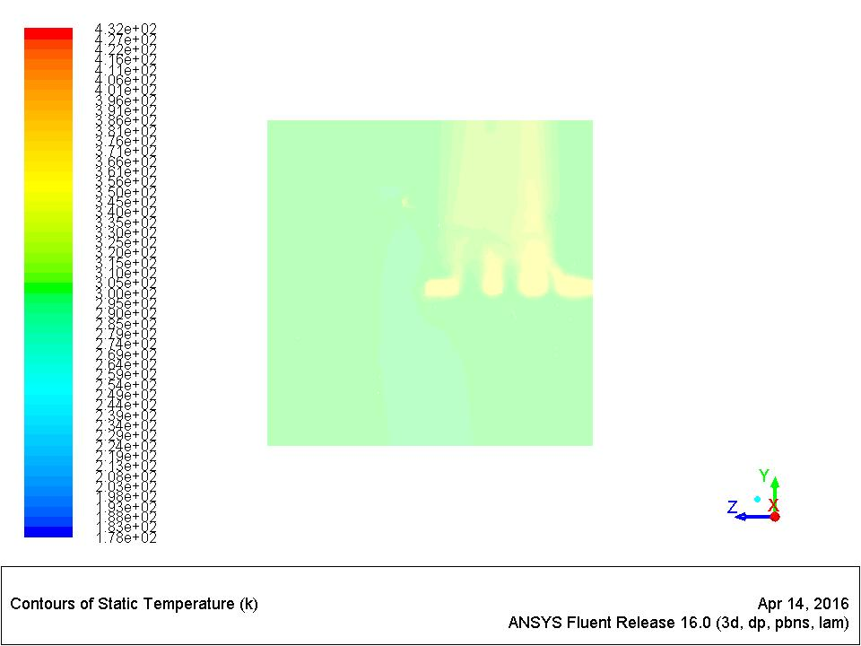
EFFECT OF HOLE DIA ON TEMPERATURE
23mm hole dia variable hole

Slide 25
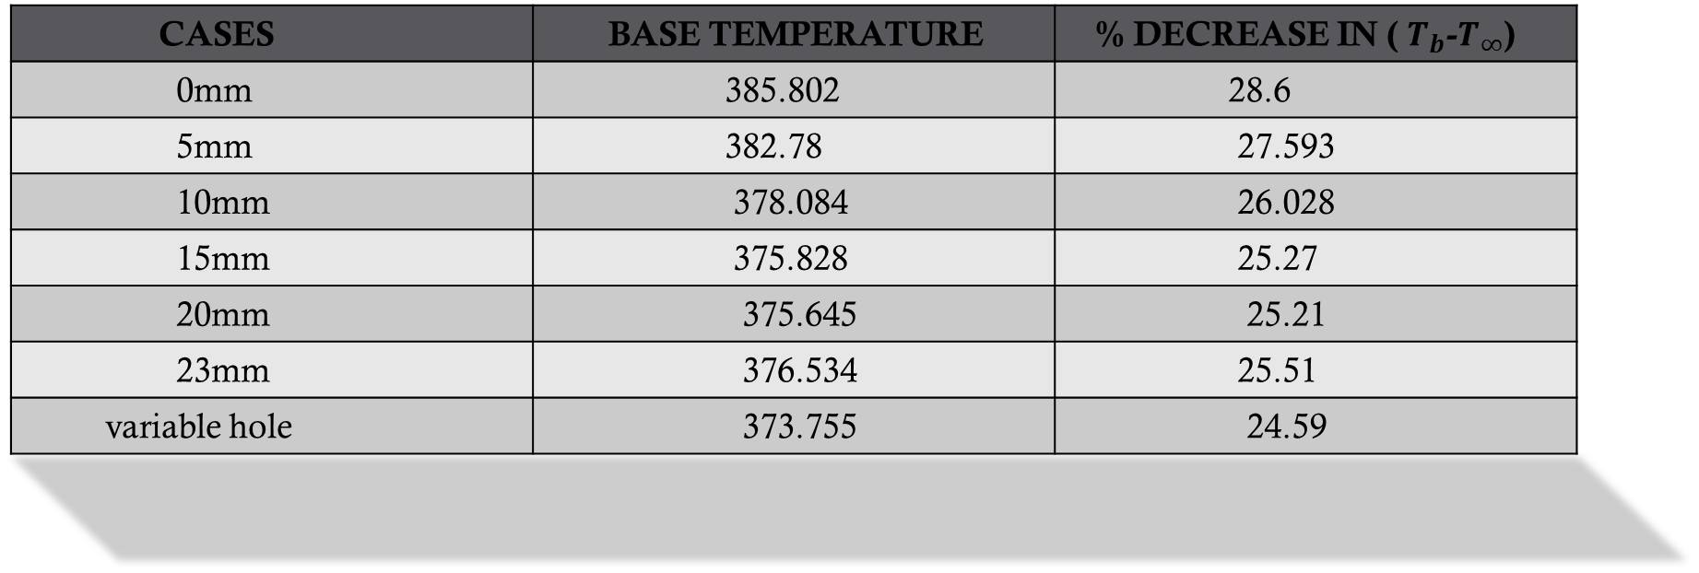
BASE TEMPERATURE COMPARISON
CASES | BASE TEMPERATURE | % DECREASE IN ( $T_{b}$-$T_{∞}$)
0mm | 385.802 | 28.6
5mm | 382.78 | 27.593
10mm | 378.084 | 26.028
15mm | 375.828 | 25.27
20mm | 375.645 | 25.21
23mm | 376.534 | 25.51
variable hole | 373.755 | 24.59

Slide 26
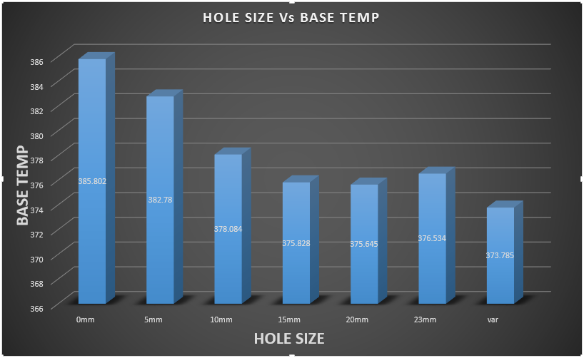
BAR CHART

Slide 27
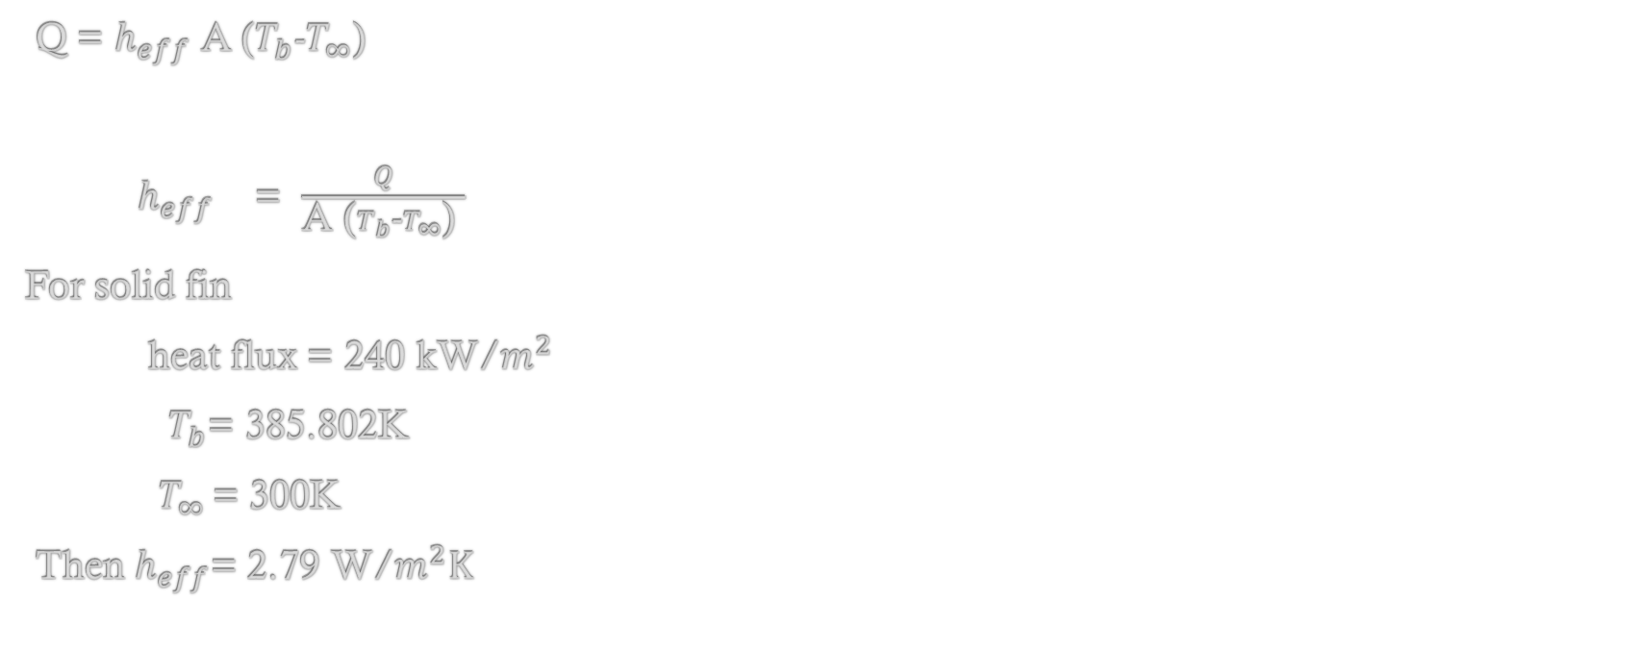
EFFECT ON HEAT TRANSTER COEFFICENT
Q = $h_{eff}$ A ($T_{b}$-$T_{∞}$)
$h_{eff}$ = $\frac{Q}{\text{A}\text{ (}T_{b}\text{-}T_{∞}\text{) }}$
For solid fin
heat flux = 240 kW/$m^{2}$
$T_{b}$= 385.802K
$T_{∞ }$= 300K
Then $h_{eff}$= 2.79 W/$m^{2}K$

Slide 28
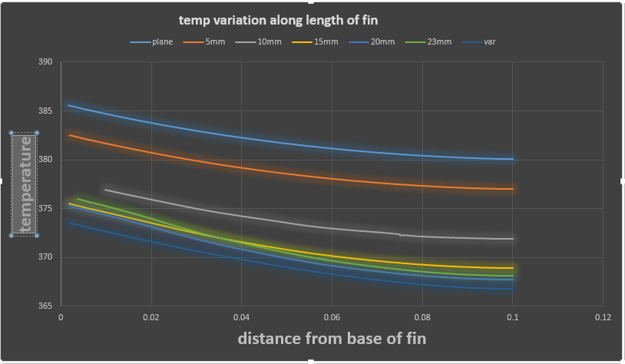
TEMPERATURE DISTRIBUTION ON TOP ALONG LENGTH

Slide 29
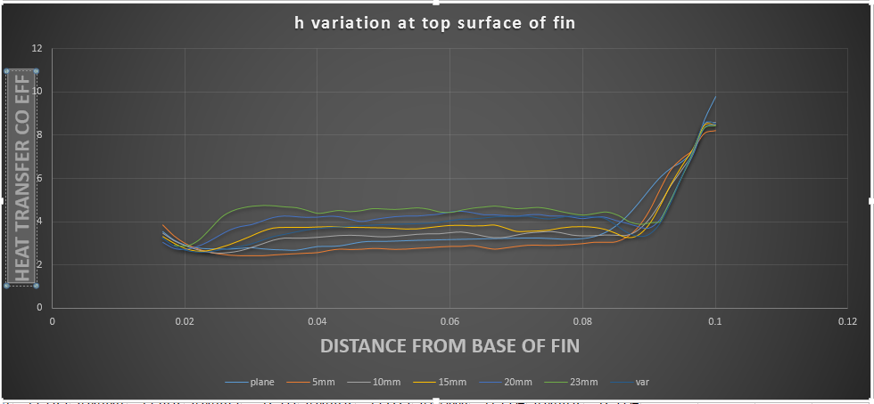
HEAT TRANSFER COEFF ALONG LENGTH

Slide 30
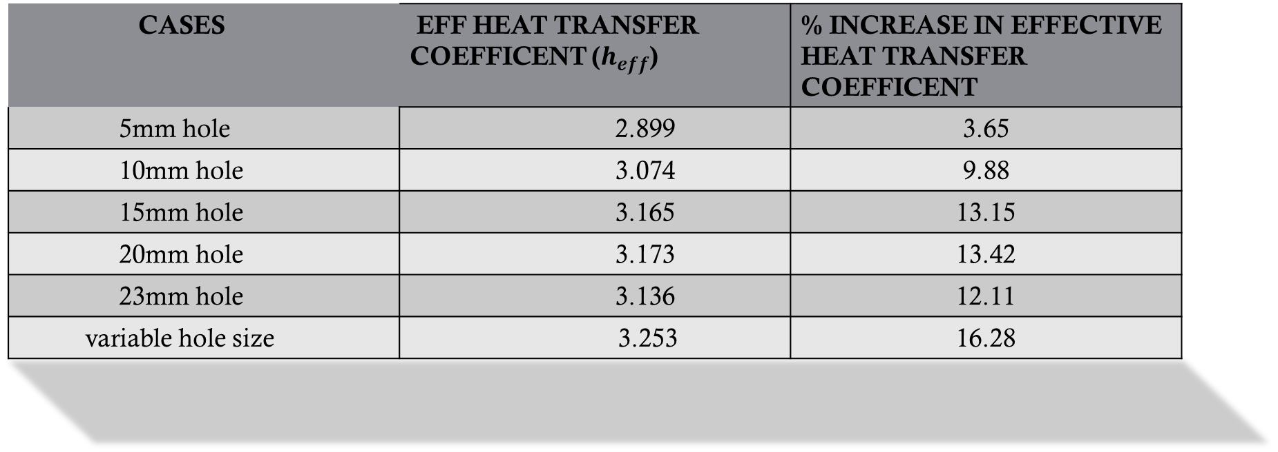
EFFECTIVE HEAT TRANSFER COEFFICENT
CASES | EFF HEAT TRANSFER COEFFICENT ($h_{eff}$) | % INCREASE IN EFFECTIVE HEAT TRANSFER COEFFICENT
5mm hole | 2.899 | 3.65
10mm hole | 3.074 | 9.88
15mm hole | 3.165 | 13.15
20mm hole | 3.173 | 13.42
23mm hole | 3.136 | 12.11
variable hole size | 3.253 | 16.28

Slide 31
FUTURE SCOPE
We can also analyze the heat transfer coefficient by increasing the number of holes.

Slide 32
REFERENCE
HEAT AND MASS TRANSFER by Yunus A Cengel and Afshin J Ghajar 4th edition ,
Tata McGraw Hill Education Private Limited ,NEW DELHI.
Golnoosh Mostafavi “NATURAL CONVECTIVEHEAT TRANSFER FROM INTRUPTED RECTANGULAR FINS” nov 2012 in university of TEHRAN.

